Slide 1
Emmanuel College Room 107 Redesign
Background: Daanial zafar
Functions/Objectives: Daanial zafar
Credible Decision making methods: Carl lamoureux
Proposed Design Changes: Prasanna thuraisingam
New design satisfies functions/objectives: Michael song
Life Cycle analysis: Anmol singh
Economics analysis: Anmol singh
Human factorsanalysis: Prasanna thuraisingam
Project 113 – Final Presentation
1.

Slide 2
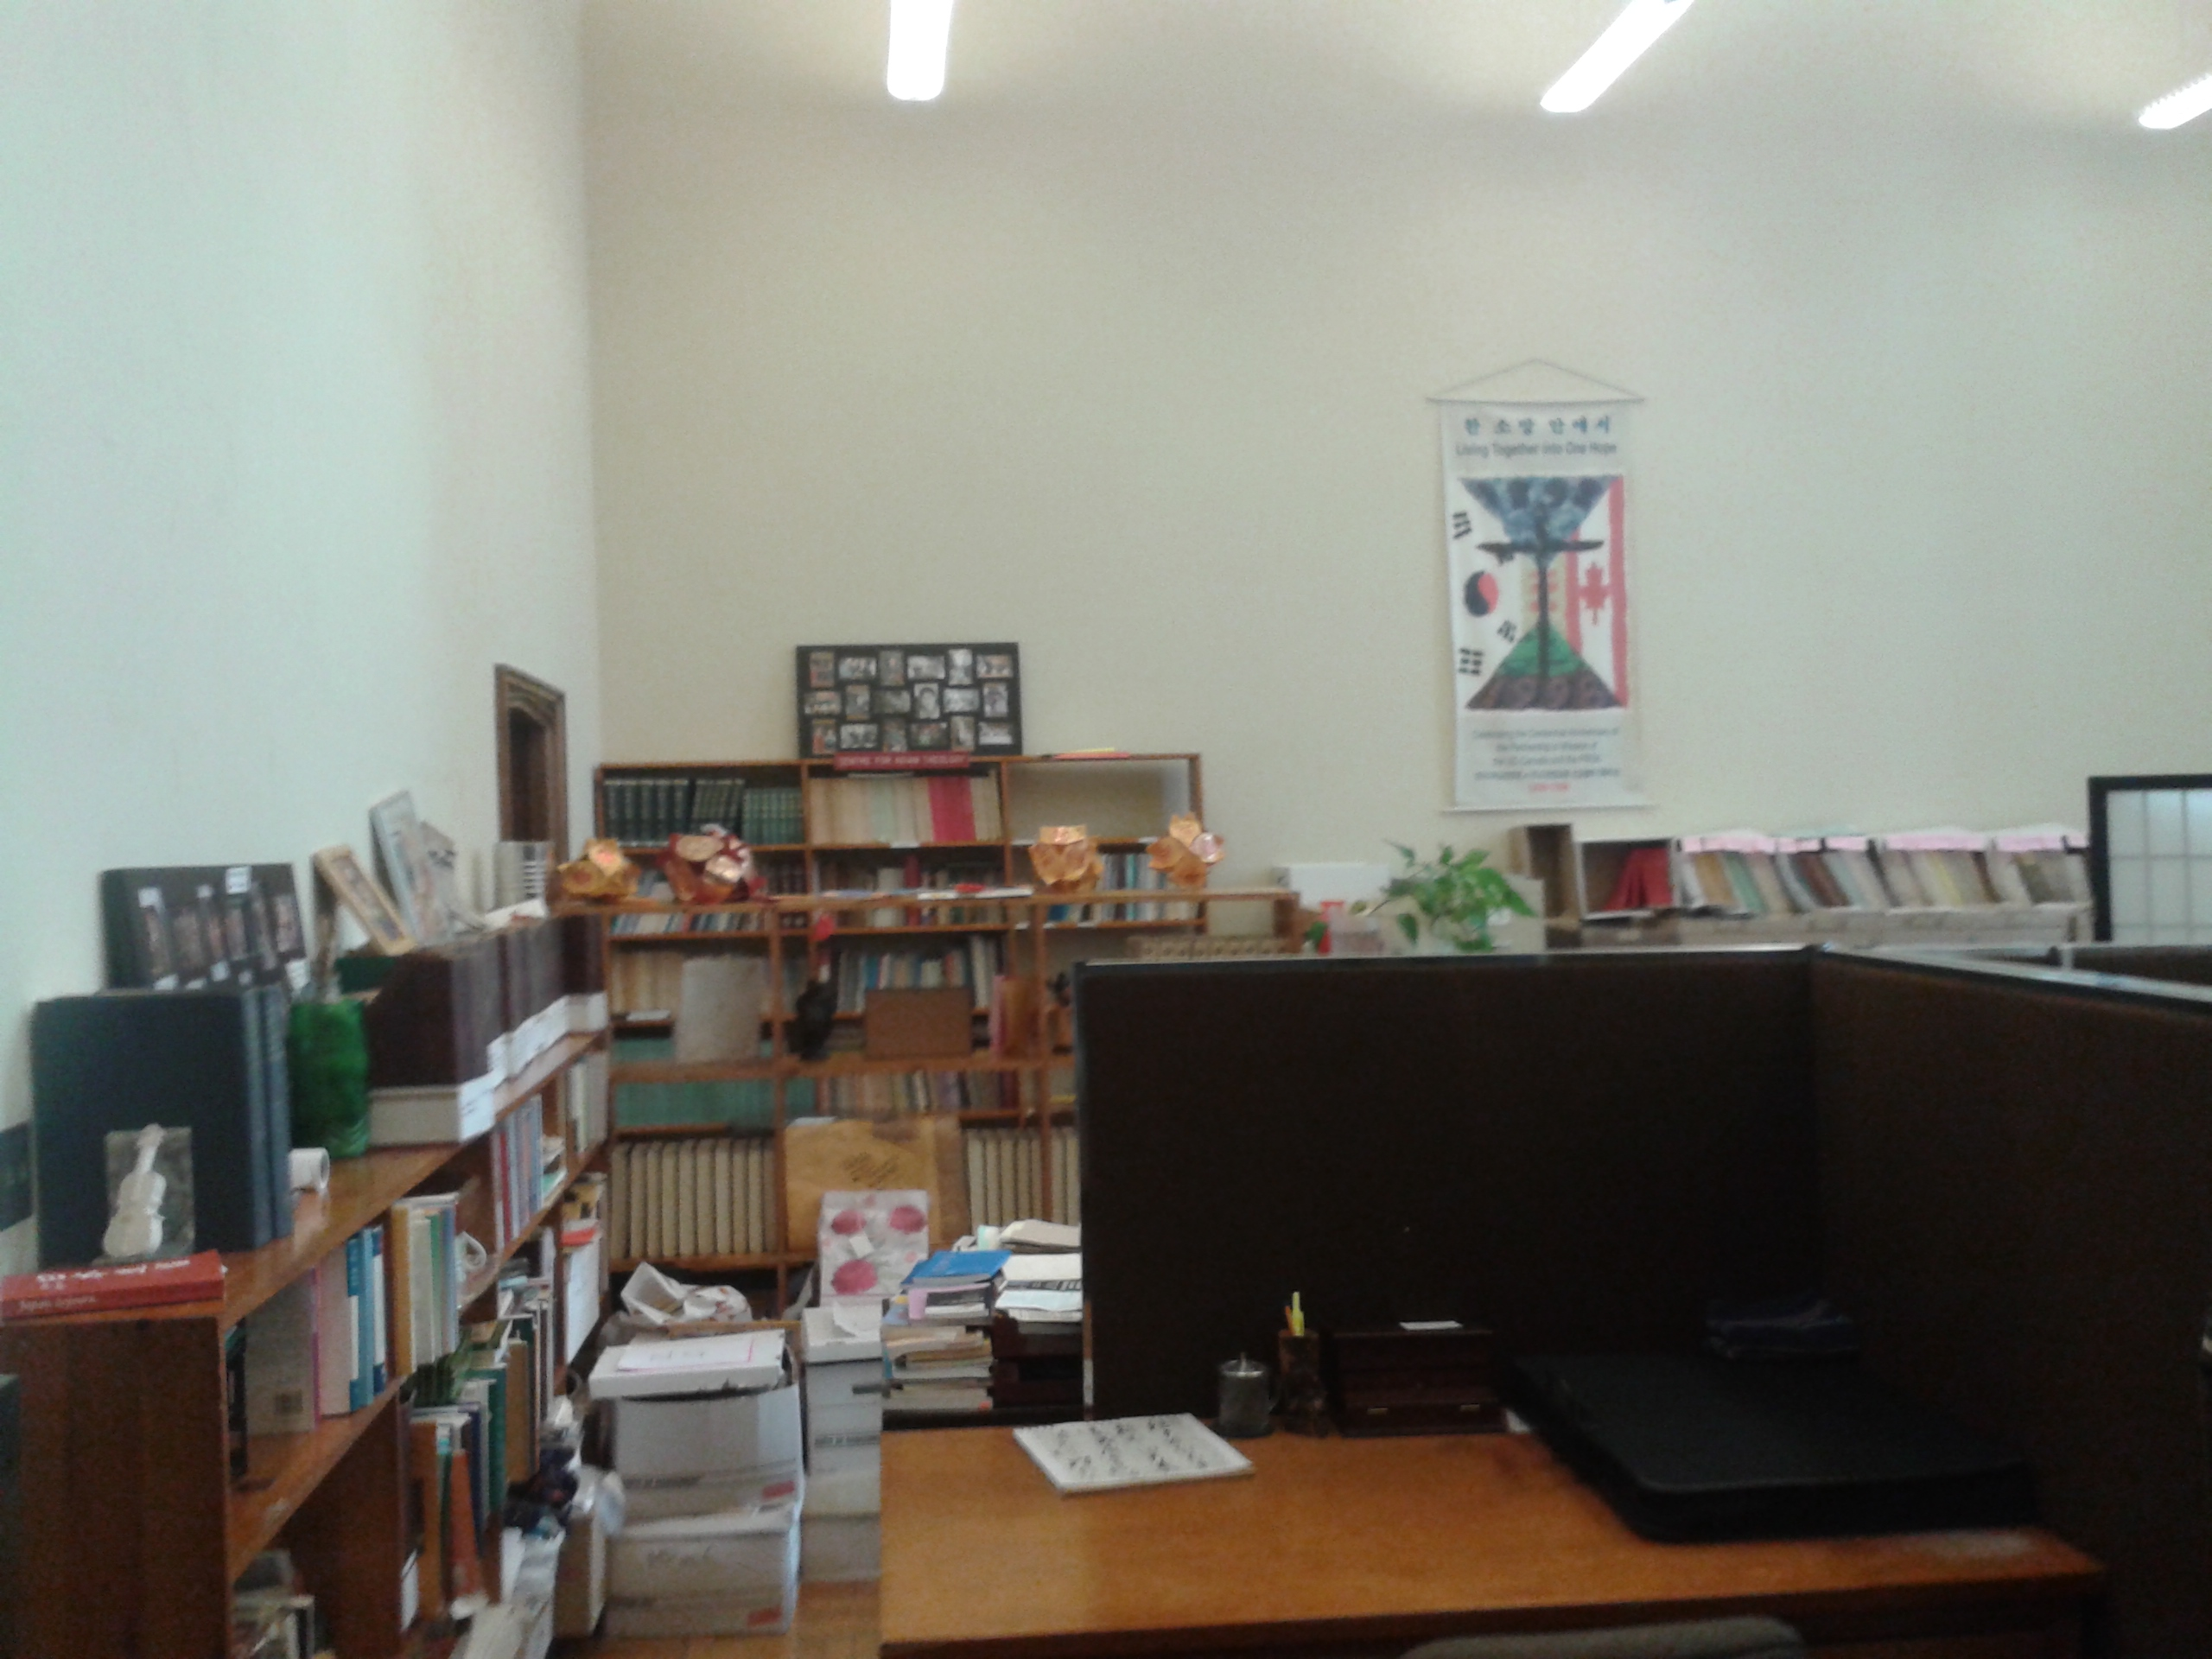
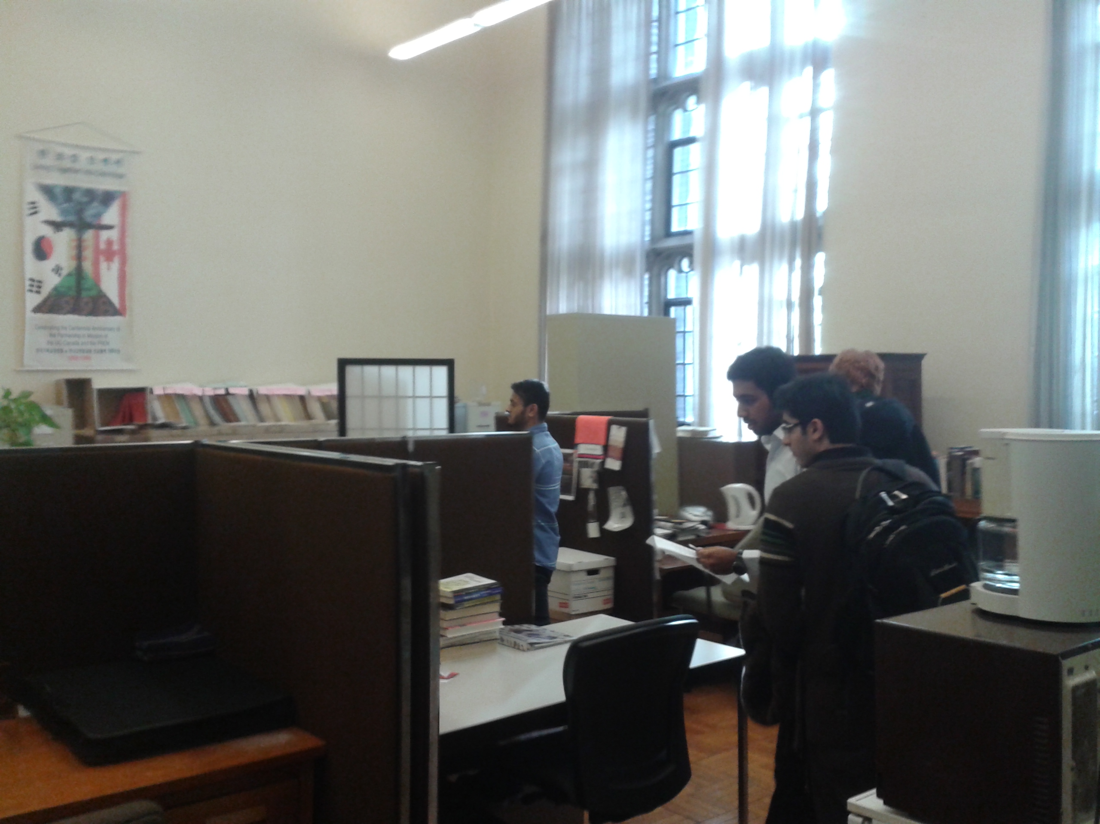
Background, Context and Problem
Daanial Zafar
2.

Slide 3
Functions and Objectives
Functions:
The design shall be a multifunctional room that facilitates:
Common Space
Privatized Office Space
Objectives:
The room should be used for all activities outlined by the client
The room should accommodate all 20 staff members
The cost should not exceed the budget of $40 000
Office space should meet the Ontario Health and Safety Guidelines concerning Workspace Ergonomics
Daanial Zafar
3.

Slide 4
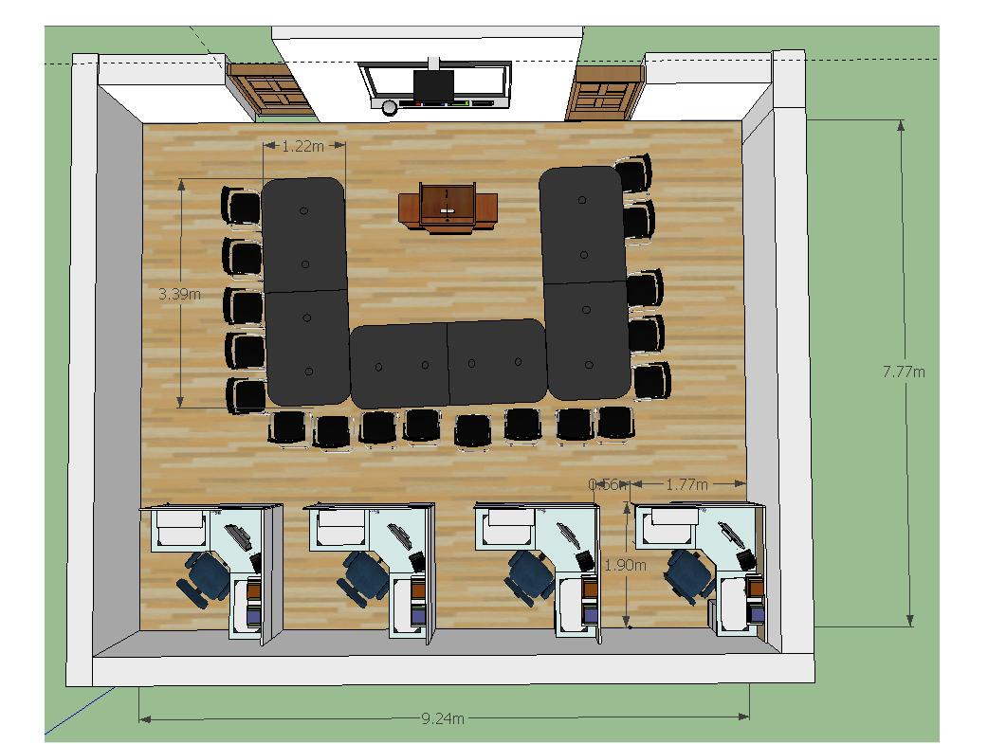
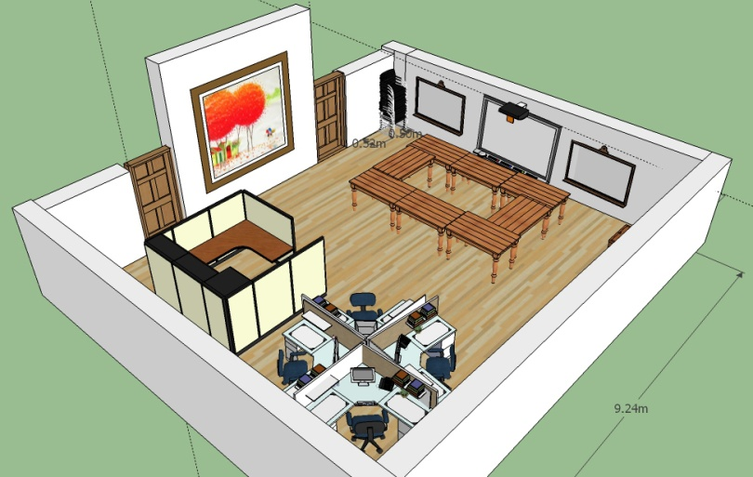
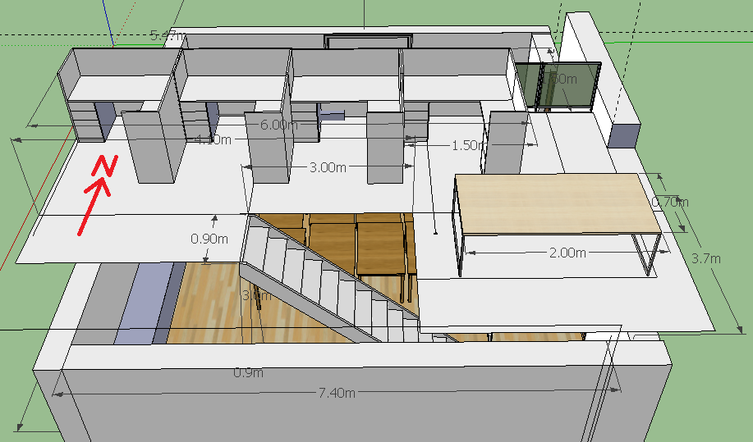
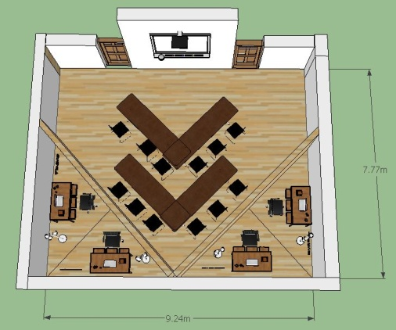
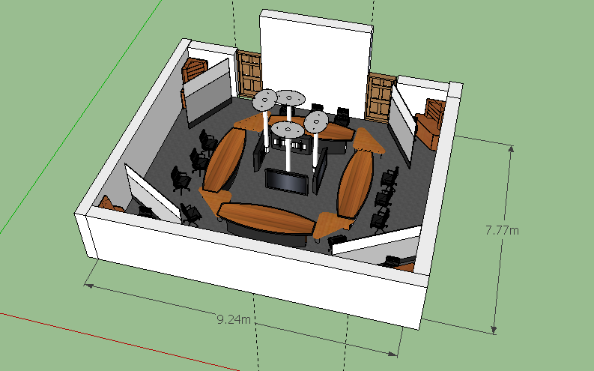
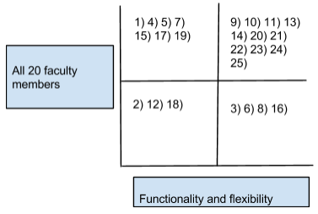
Credible Decision Making Methods
Functional Decomposition
Private Workspace
Separate Office Space
Room Division
Multimedia
Common Space
Lighting
Objective Comparison Graph
Top 5 designs = 5 conceptual designs
Weighted Decision Matrix
Determined proposed design
Carl Lamoureux
4.

Slide 5
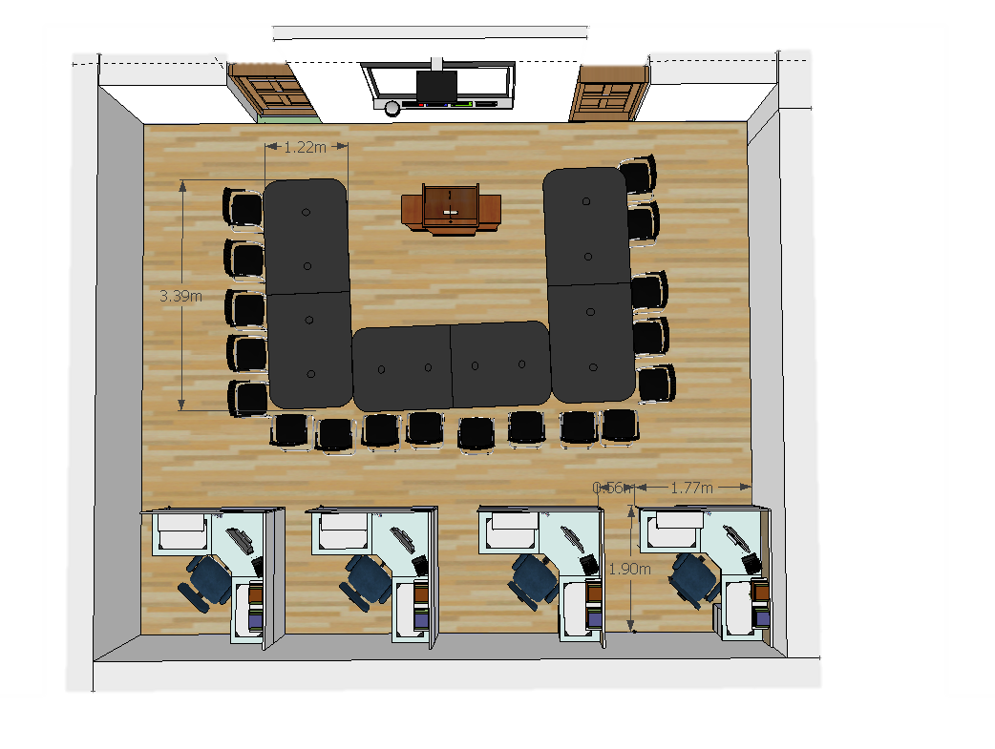
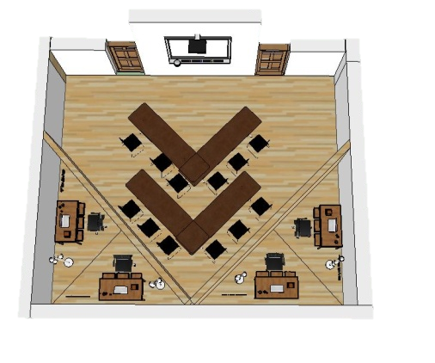
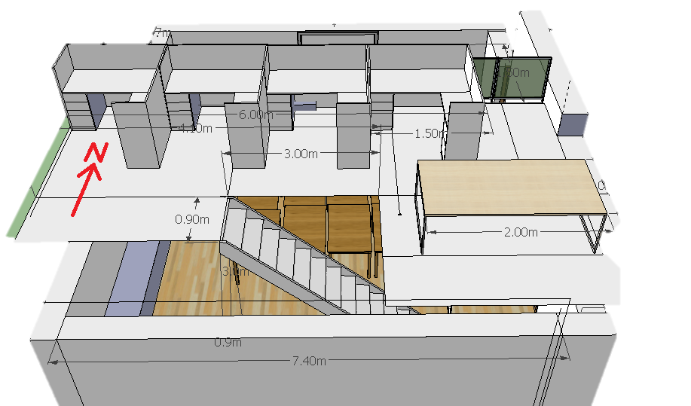
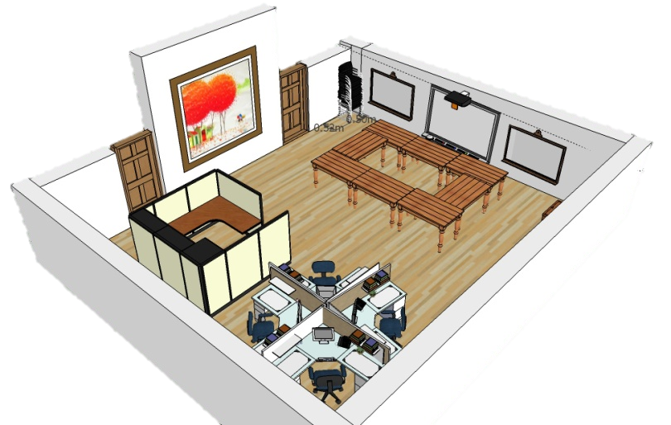
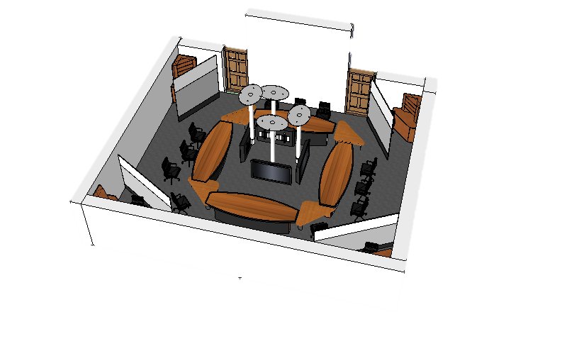
 | Weight | 60/40 Split | Second Level | V - Split | Rectangle & Squares | Octagon
Flexibility | 27% | 70% | 50% | 40% | 60% | 40%
# of People | 23% | 40% | 60% | 20% | 40% | 30%
Cost | 15% | 65% | 20% | 30% | 40% | 25%
OHSG | 10% | 50% | 70% | 40% | 50% | 30%
TOTALS: | 100% | 42.85% | 37.30% | 23.9% | 36.40% | 24.45%
Carl Lamoureux
5.

Slide 6
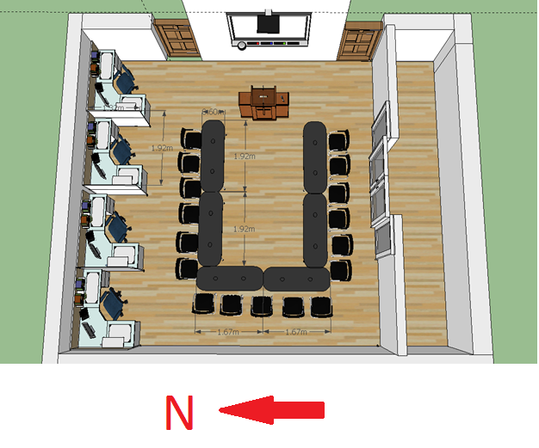
Proposed Design Changes
Original design
Final design
Prasanna Thuraisingam
6.

Slide 7
Design Satisfies Functions
The design will have two components:
Common Area:
Receptions
Meetings
Modular furniture facilitates space for reception as well as hosts meetings.
Privatized Office Space:
Cubicle height creates private work environment.
Michael Song
7.

Slide 8
Design Satisfies Objectives
The room should be used for all activities outlined by the client
The modular furniture allows many layouts to serve many purposes.
The room should accommodate all 20 staff members either sitting or standing
Table dimensions support 20 people.
Space when furniture is stored is > 45m^2.
The cost should not exceed the budget of $40 000
Furniture balances cost with quality.
Office space should meet the Ontario Health and Safety Guidelines concerning Workspace Ergonomics
Cubicle dimensions and workspace furniture specifically chosen in regards to OHSG.
Michael Song
8.

Slide 9
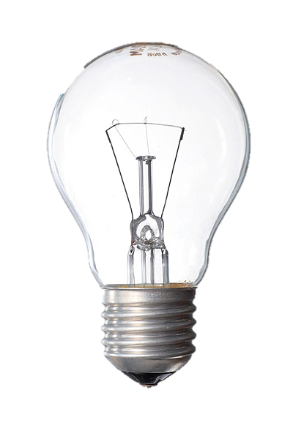
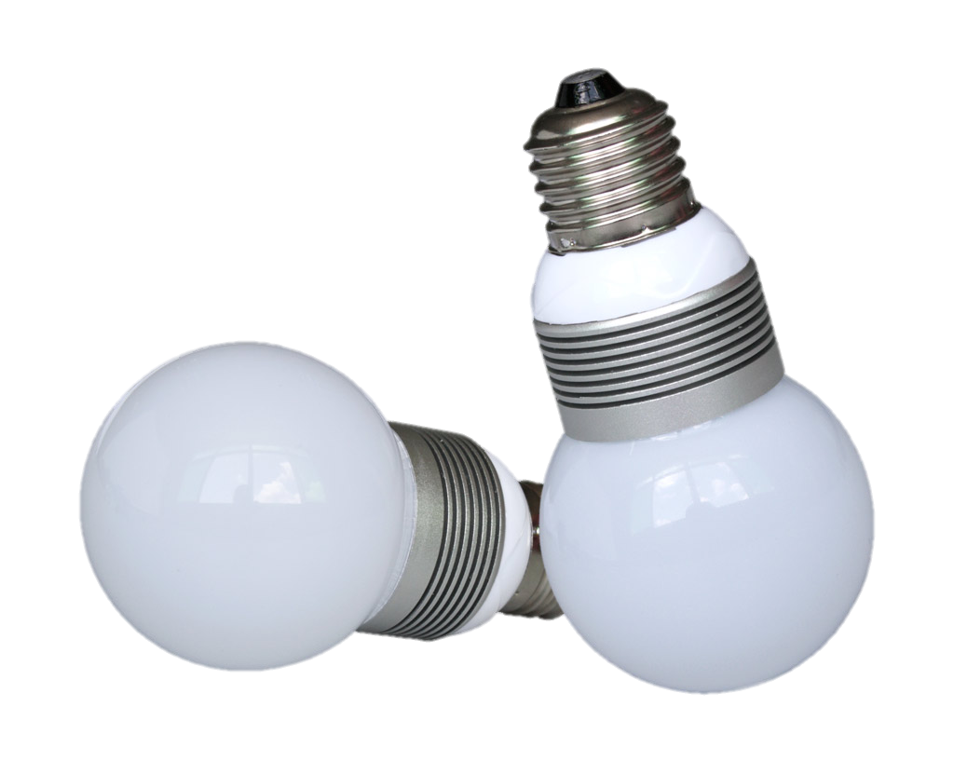
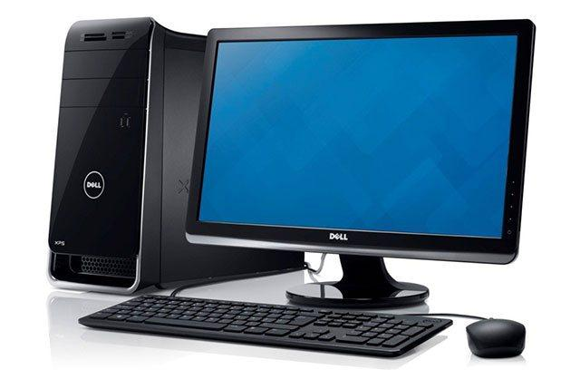

Life Cycle Analysis: Making smart choices
Computers
Arsenic-free display glass
Mercury-free LED display
BFR-free
PVC-free cords and cables
Light Bulbs
Mercury-free
Up to 85% less power usage *
Last 20 times longer *
Easy to recycle
Power Consumption
Idle Power Usage: 37 Watts
Working Power Usage: 7.99 Kilowatt Hours
Idle Power Usage: 59.4 Watts
Working Power Usage: 12.9 Kilowatt Hours
Anmol Singh
9.
* As compared to incandescent light bulbs

Slide 10
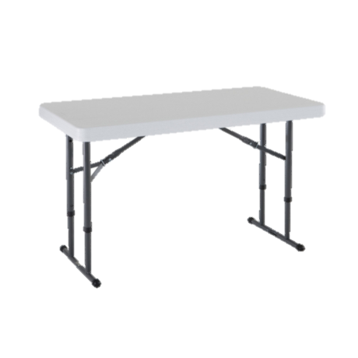
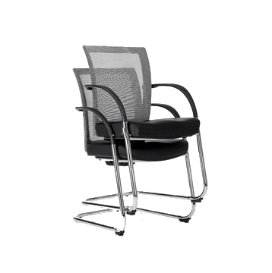
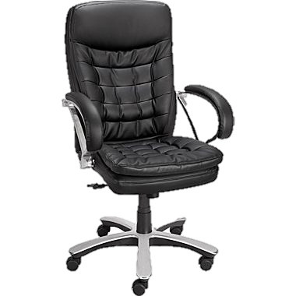
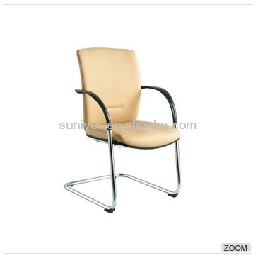
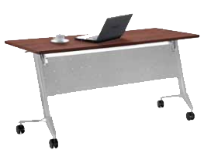
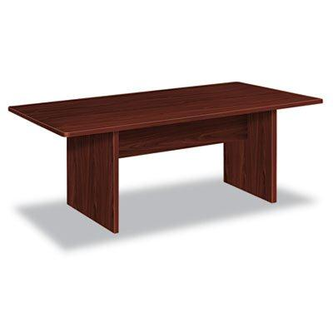
Economics Analysis: Balancing Cost, Comfort and Flexibility
$79.99/piece
$199.99/piece
$41.99/piece
$209.99/piece
$178/piece
$58/piece
[1][2][3][4]
Anmol Singh
10.

Slide 11
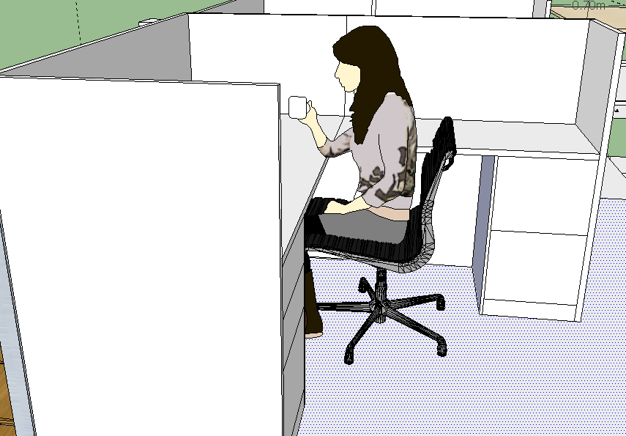
Human Factor Analysis: Physical – Proportions and Dimensions
Prasanna Thuraisingam
11.

Slide 12
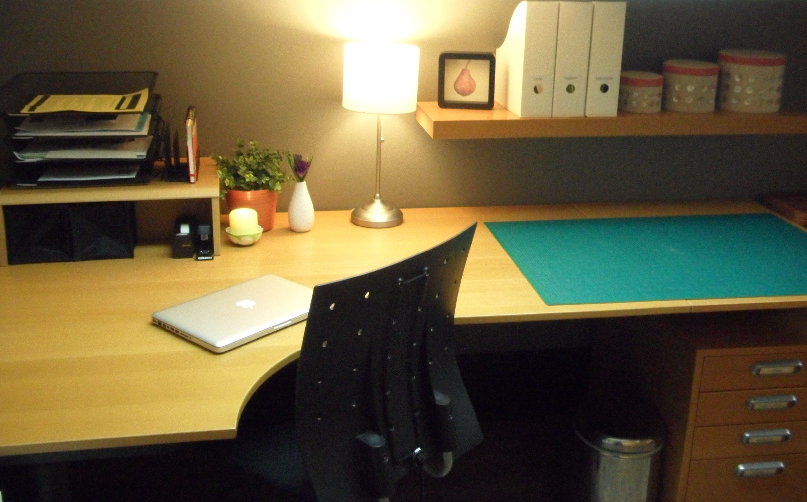
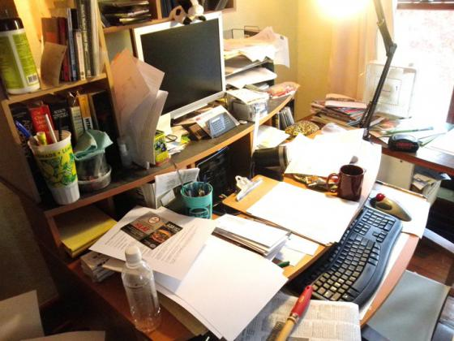
Human Factor Analysis:
Psychological – Productivity in Workspace
Prasanna Thuraisingam
12.

Slide 13
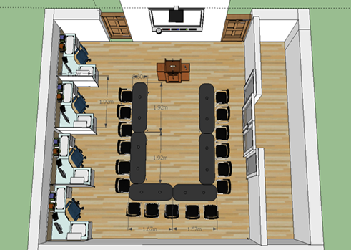
Human Factor Analysis: Psychological - Power to the Speaker
Prasanna Thuraisingam
13.

Slide 14
Summary
Engineering decision making methods provide design credibility:
Functional decomposition
Objective comparison graph
Weighted decision matrix
Analyses show balance between client wants and FOCs:
Life Cycle: Design balances comfort with environmental sustainability
Human Factors: Design balances ergonomics with functionality
Economics: Design balances minimal cost with quality
Industry recognized analytical techniques provide credibility to a design proposal.
Daanial Zafar
14.

Slide 15
References
[1] LEDARE LED bulb E26, globe opal white [Online] Available: http://www.ikea.com/ca/en/catalog/products/20266744/
[2] Conference Tables [Online] Available: http://www.source.ca/pdfs/flyer/Conference.pdf
[3] Apple iMac 21.5" 4th Gen Intel Core i5 2.7GHz Computer (ME086LL/A) - English [Online] Available: http://www.bestbuy.ca/en-CA/product/apple-apple-imac-21-5-4th-gen-intel-core-i5-2-7ghz-computer-me086ll-a-english-me086ll-a/10218580.aspx?path=bd53f18fd08cd489b63fc82735869fe7en02
[4] Stackable Conference Chairs [Online] Available: http://www.alibaba.com/product-detail/Stackable-conference-chairs_1717557211.html

